Slide 1
Victory Charter School 6-12
2021-2022 School Grade: D 2022-2023 School Grade: N/A

Slide 2
What is Title I?
Title I is the largest federal assistance program for the nation’s schools.
The goal of Title I is to provide supplemental funds to assist with closing the achievement gap.
The funds are disbursed from the federal government, to the State of Florida, and then to the Local Education Agency (LEA), which is the District.
The District follows the LEA plan for disbursement to the schools.
Victory Charter School 6-12 is a Title I school because more than 70% of the students meet poverty requirements.

Slide 3
What is the LEA Title I Plan?
The LEA Title I Plan is the District’s annual plan for district strategic initiatives to increase academic achievement.
The LEA Title I Parent and Family Engagement Plan is a component of this plan.
Some items included are:
Student academic assessments
Staff Qualifications and Professional Development
Parental Involvement Strategies, including the LEA Parent and Family Engagement Plan
School improvement goals
Title I parents/guardians have the right to be involved in the development of the LEA Title I Plan and the LEA Parent and Family Engagement Plan.

Slide 4
What is a School-Wide Title I Plan?
Each school receiving Title I funds must have a plan.
The school-wide plan components are included in the School Improvement Plan (SIP)
Title I parents/guardians have the right to be involved in the development of (Victory Charter School 6-12) School Improvement Plan (SIP)

Slide 5
School Improvement Planning
Our school has identified the following areas of focus for 2023-2024:
1. (Math Proficiency & Learning Gains)
2. (ELA Proficiency & Learning Gains)
3. (Science Proficiency)
4. (ESE Proficiency)
5. (ELL Proficiency)
Please visit our monthly School Advisory Committee (SAC) meetings, where we discuss our progress and how we can raise achievement.
During the months of September, December, and March, we will review, discuss, and solicit feedback regarding the school’s Title I and Parent & Family Engagement plans.

Slide 6
School Improvement Plan Scores
Student scores for the 2022-2023 Florida Standards Assessment (FSA)
and/or End-of-Course (EOC) are listed below:
Our school’s 2023-2024 School Improvement Plan can be accessed at:
https://www.floridacims.org/districts/osceola
Each school year, we use the previous year’s scores to determine
our school improvement goals for the next year.

Slide 7
How does Victory Charter 6-12 use Title I and SIP funds?
Federal Title I funds must supplement the school’s existing programs. At our school we use Title I funds to:
Add academic coaches to our staff
Add paraprofessionals to the classroom
Purchase supplemental classroom materials and supplies
Provide tutoring
Provide professional development for teachers
Purchase supplemental software and technology equipment
Conduct parental educational meetings/trainings/activities

Slide 8
What is the 1% set-aside and how are parents involved?
For the 2023-2024 school year, the Title I allocation for The School District of Osceola County is $21,832,791.04. Federal law requires the LEA to set aside 1% for parent and family engagement.
90% of the 1% amount must be allocated to all District Title I schools to implement school-level parent and family engagement. Our school received $ 2,840.58
The School District of Osceola County (LEA), will use the remaining 10% of the 1% for parent and family engagement, as well as parent and family events and training.
Title I parents/guardians have the right and are encouraged to be involved in how this money is spent at the LEA and school level.

Slide 9
What is the Parent and Family Engagement Plan?
The LEA and each Title I school creates a Parent and Family Engagement Plan (PFEP)
This PFEP explains how the requirements of the Every Student Succeeds Act of 2015 (ESSA) will be implemented at both the District and School levels.
It includes:
Expectations for parents
How parents will be involved in decision-making
How the LEA and schools will work to build the schools’ and parents’ capacity for strong parent and family engagement to improve student academic achievement
Title I parents/guardians have the right to be involved in the development of the School and District Parent and Family Engagement plans.

Slide 10
Input on spending Title I Parent Involvement Funds
To use funds for Parent Involvement, schools must meet the following criteria:
1. Educate the parents on Title I
2. Ensure funds are aligned towards academic achievement
(Language Arts, Math or Science)
3. Have educational interaction between the parent and student
Please provide suggestions on utilizing Title I Parent and Family Engagement funds at our school.

Slide 11
How is the evaluation of the
Parent and Family Engagement Plan conducted?
Evaluation Requirements
Annual evaluations with Title I parents/guardians
Parent/guardian surveys (required)
Focus groups
Parent Advisory Committees
Analyze content and effectiveness of the current plan
Identify barriers to parental involvement
Data/Input may include:
Process and timeline
How the evaluation helps create next year’s plan

Slide 12
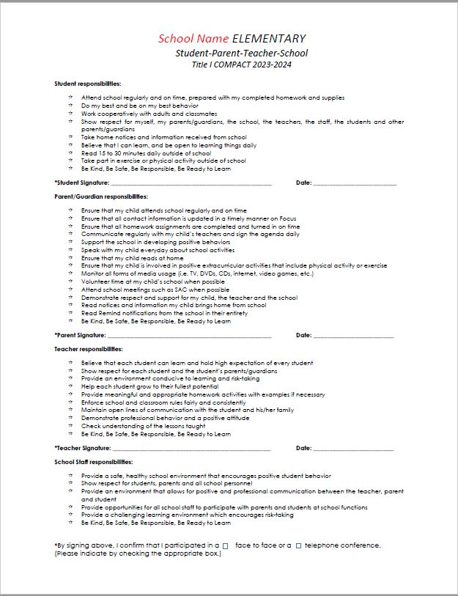
What is the
School-Parent Compact?
The Compact is a commitment from the school, the parent, and the student to share in the responsibility for improved academic achievement.
Title I parents/guardians have a right to be involved in the development of the School-Parent Compact.

Slide 13
What are the Standards
my child is expected to achieve?
State of Florida adopted the ELA Florida’s B.E.S.T. Standards K-12 and Mathematics Florida Standards (MAFS)
The MAFS and B.E.S.T. provide clear educational standards while allowing local districts and schools the flexibility needed to deliver quality instruction in the classroom.
The standards (which are not to be confused with curriculum or instruction) are designed to ensure all students, regardless of demographics, graduate high school prepared to enter college or the workforce.
The standards are internationally benchmarked and provide our students with an edge in the global jobs market by ensuring mastery of knowledge and skills needed to perform today's high-skill, high-wage occupations.

Slide 14
Our Curriculum
ELA |  | Math
Spring Board | MyPerspectives | Reveal | Carnegie
Science | Social Studies
Discovery Ed | McGraw Hill

Slide 15
Our Digital Programs
ELA | Reading | Math
Reading Plus | Read 180 | Khan Academy

Slide 16
How is the school evaluating
my child’s achievement?
Entry/exit placement tests for English as a Second Language (ESOL)
FAST Reading Progress Monitoring (Grades 6-10)
FAST Reading Progress Monitoring (Grades 6-8)
BEST/NGSSS End of Course Exams (Algebra, Geometry, Biology, U.S. History and Civics) Florida Statewide Science Assessment (Grades 8)
End of year assessments for all courses (Grades 9-12)
Florida Standards Assessments (Grades 3-10)
Next Generation Sunshine State Standards (NGSSS) FCAT 2.0 Science Assessment (Grades 8)

Slide 17
How do I request the qualifications of my child’s teachers?
Title I parents/guardians have the right to request the qualifications of their child’s teachers.
The Title I Information booklet explains parents’ rights.
To request qualifications:
Request from the principal in writing
Access the information at http://www.fldoe.org/edcert/public.asp
Every Student Succeeds Act (ESSA) – four-week notice
Our school presently has (28) of state certified teachers
(15) teachers who are teaching “out of field”
Information is sent home twice a year

Slide 18
What are my rights as a Title I Parent/Guardian?
You have the right to:
An opportunity to schedule regular meetings to make suggestions and participate, as appropriate, in decisions that relate to your child's education
Expect a response to any suggestions in a timely manner
Submit comments on the school-wide plan as soon as it is available to the LEA, if you do not believe it to be satisfactory
Be involved in how funds are allocated and spent at the LEA and school level
Be involved in the development of the LEA and School Title I Plans
Be involved in the development and review of the School and District Parent and Family Engagement Plans (PFEP)
Be involved in the development of the school-parent compact
Be involved in the development of the School Improvement Plan (SIP)
Request the qualifications of your child’s teachers

Slide 19
How can I become involved?
School Level
Listen for automated calls/reminders from school
Watch for flyers/invitations to come home
Attend SAC meetings
Attend PTO meetings
School website/social media
District Level
Listen for automated calls/reminders from the district
Watch for flyers/invitations to come home
Attend PAC meetings
District website/social media

Slide 20
Who are my Title I contacts
at the school?
Name | Phone | E-mail address
Ms. Maria DaSilva | 321-697-3800 | mdasilva@victorycharterschools.org
https://victorycharterschools.org/
For more information about Title I schools, please visit www.osceolaschools.net/specialprograms

Slide 21
We’re here to make GOOD
THINGS happen for other people.
Any questions?

